Slide 1
PRESENTATION ON HOME AUTOMATION SYSTEM
NAME: AANCHAL SHARMA
UNI ROLL NO: 2014352
SECTION: CST

Slide 2
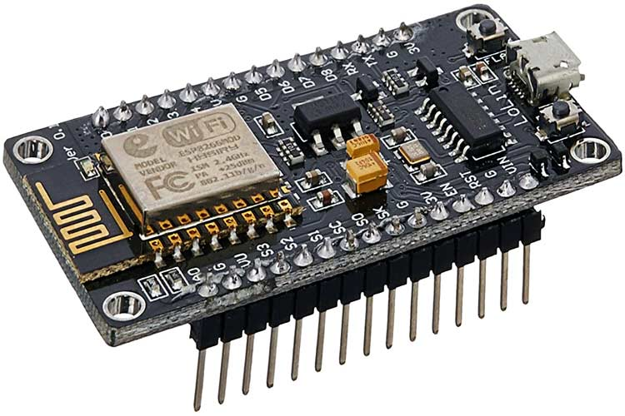
HARDWARE USED IN MODEL
NodeMCU- It connect objects and let data transfer using the Wi-Fi protocol.
Some of the advantages are:
Low Cost
Integrated support of Wi-Fi
Smaller board size
Low energy consumption

Slide 3
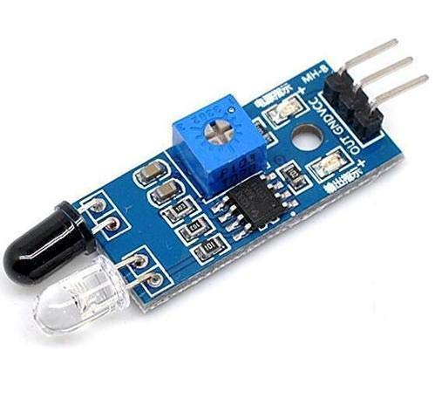
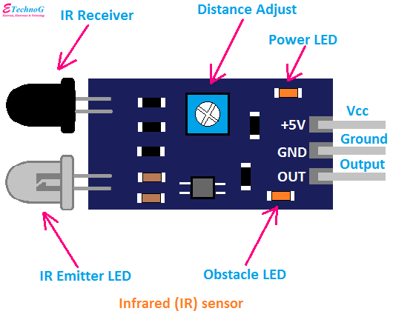
2. IR SENSOR- It is used in wireless technology like remote controlling functions and detection of surrounding objects/ obstacles. IR sensors mainly consist of an Infrared(IR) LED and a Photodiode, this pair is generally called IR pair.

Slide 4
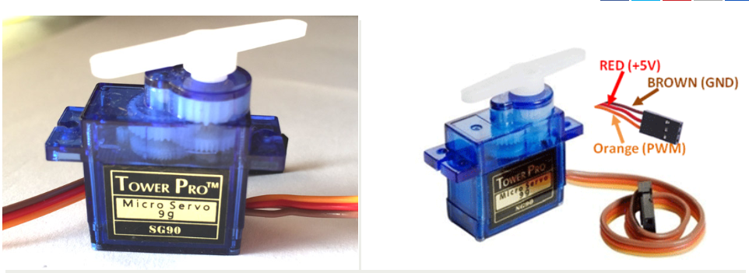
3. SERVO MOTOR- closed-loop mechanism that incorporates positional feedback in order to control the rotational or linear speed and position. Here it is acts as fan.

Slide 5
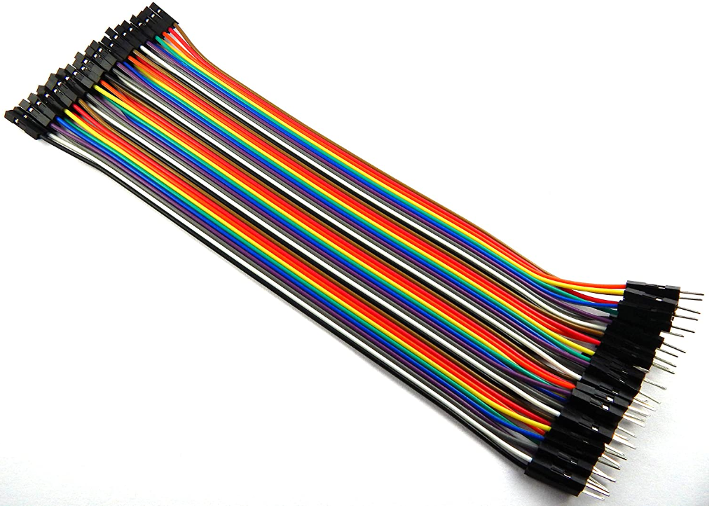
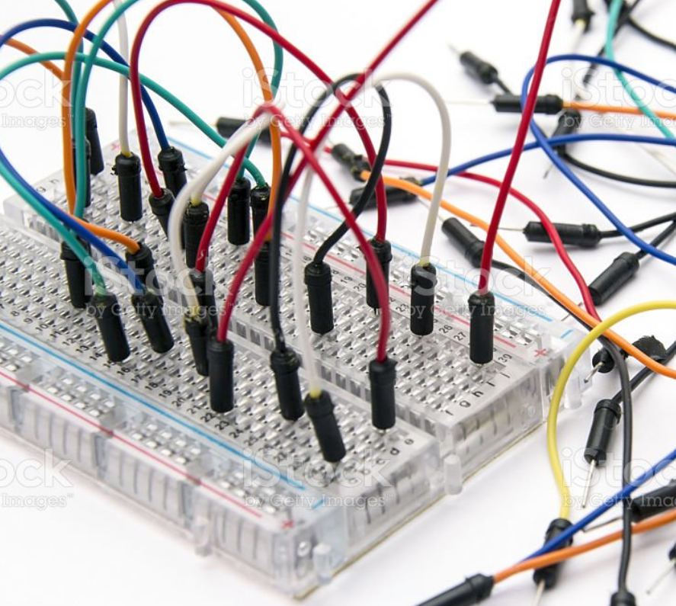
4. JUMPER WIRES- A jumper wire is an electric cable used for connecting remote electric circuits on printed circuit boards.

Slide 6
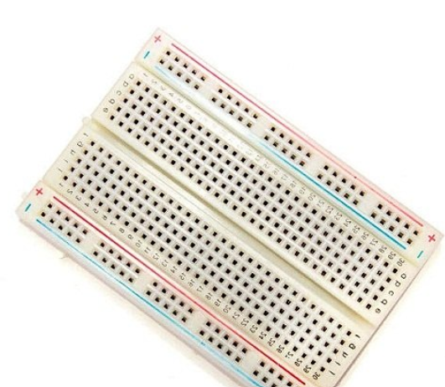
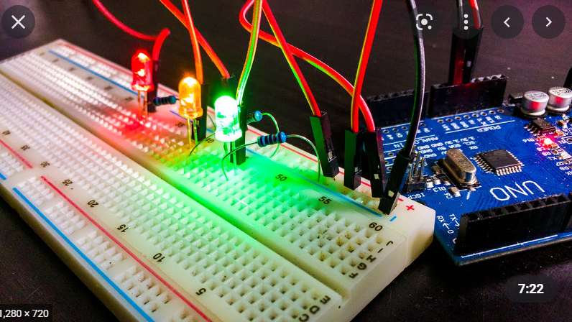
5. BREADBOARD- A breadboard is used to create temporary circuits. It is beneficial to designers since it permits components to be readily removed and changed.

Slide 7
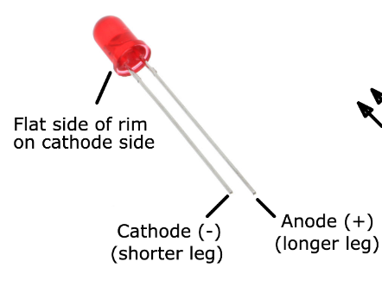
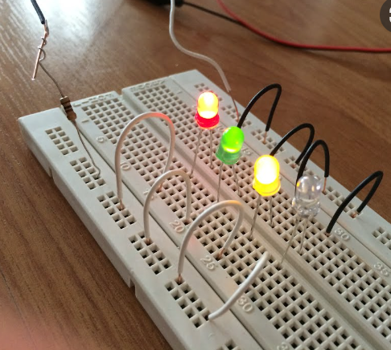
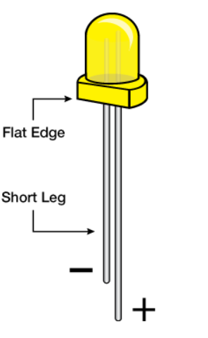
6. LED (LIGHT EMITTING DIODES)-are small, bright, power-efficient lights commonly used in electronic products. each LED has a positive leg and a negative leg. These can be identified visually by length: the negative leg has been made shorter.

Slide 8
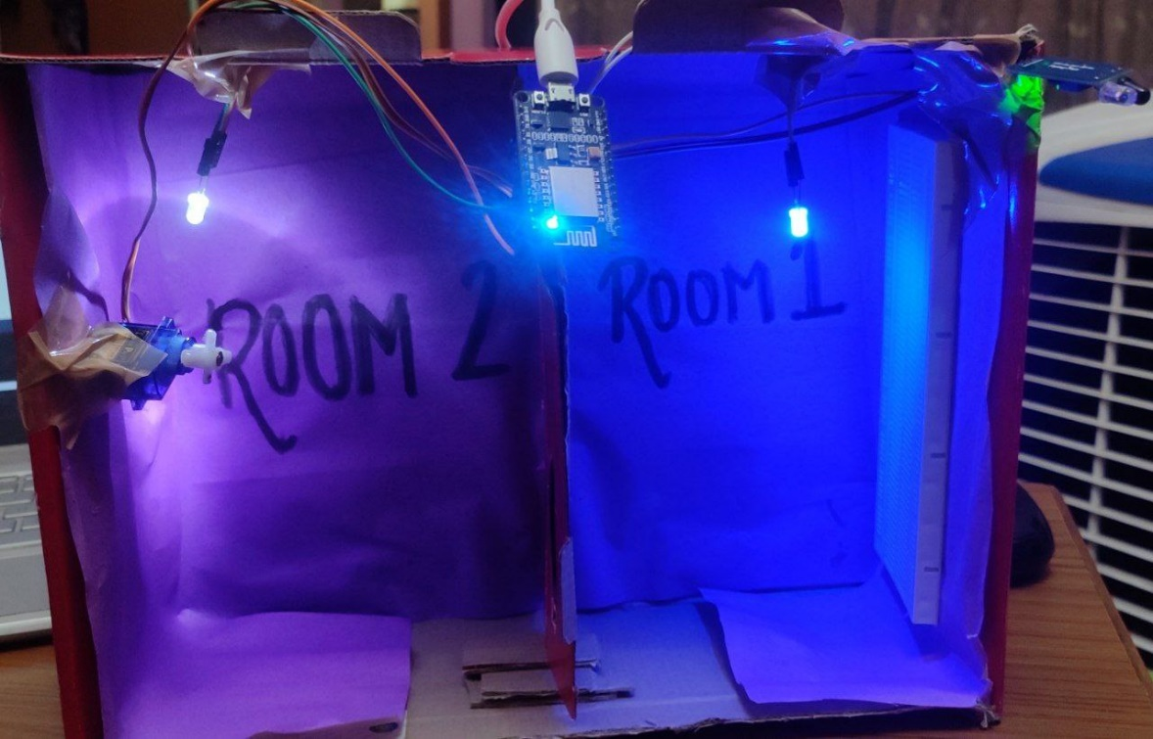
THE FINAL MODEL

Slide 9
THANKYOU

